Slide 1
Physics presentation
Instructor: Sir Sahib khan

Slide 2
objectives
introduction Semiconductor
Types of semiconductor
Dopping
P_type
N_type
Different b/w p and n type
5_How these types are created
Semiconductor materials
Vishaka
Simran
Taiba

Slide 3
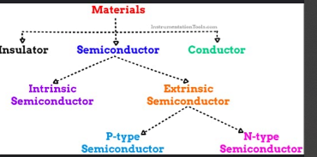

Slide 4
introduction to semiconductor materials
A semiconductor is a material that has electrical conductivity between a conductor and an insulator.
that can sometimes conduct electricity and sometimes block it, depending on the conditions like temperature or voltage.
t is not as good at conducting electricity as a metal, and not as bad as an insulator — it's in the middle.
Example of semiconductor
Silicon(SI)
Germanium(Ge)
Gallium Arsenide(GaAs)

Slide 5
Why are Semicondutors special?
Semiconductors are unique because we can control how much electricity they allow to pass. This control makes them perfect for electronics.
They are the building blocks of:
Transistors
Diodes
Integrated Circuits (ICs)
Microprocessors (in computers and phones)

Slide 6
Types of Semiconductors
Intrinsic Semiconductor
Extrinsic Semiconductor
This is a pure semiconductor (like pure silicon).
No other elements are mixed in.
It has very few free electrons,
so it does not conduct electricity well.
Only when we heat it,
some electrons move and carry current.
This is a modified semiconductor.
We add a small amount of impurity atom
(this is called doping).
Doping helps the material conduct electricity better.

Slide 7
Two types of extrinsic semiconductors:
N-Type Semiconductor (N = Negative)
We add an atom that gives extra electrons (like Phosphorus).
Now the material has more free electrons to carry current.
P-Type Semiconductor (P = Positive)
We add an atom that creates holes (spaces where electrons are missing).
These holes help electrons move, so current flows.

Slide 8
Different between p type and n type
Feature | P-Type | N-Type
Stands for | Positive | Negative
Added element | Boron (3 electrons) | Phosphorus (5 electrons)
What is added? | Holes (missing electrons) | Extra electrons
Main carriers | Holes (+) | Electrons (–)
Charge flow | Positive-like | Negative-like

Slide 9
How Are P-type and N-type Semiconductors Created?
P-type and N-type semiconductors are created by doping pure (intrinsic) semiconductors like silicon (Si) or germanium (Ge) with small amounts of impurity atoms.
What is Doping?
Doping is the process of adding impurity atoms to a pure semiconductor to change its electrical properties.

Slide 10
N-type Semiconductor (Negative-type):
How it's made: We add a tiny bit of a material like phosphorus (which has 5 outer electrons) to silicon (which has 4).
Why it works: Phosphorus uses 4 of its electrons to make bonds with nearby silicon atoms. The 1 extra electron is left over. This extra electron can move around and carry electricity.
Result: There are more free electrons, so the material conducts electricity better.
P-type Semiconductor (Positive-type):
How it's made: We add a tiny bit of a material like boron (which has only 3 outer electrons) to silicon.
Why it works: Boron can only make 3 bonds with silicon atom, one is missing an electron — this is called a hole.
Result: Electrons from nearby atoms try to fill the hole, and as they move, the hole seems to move too — this is how electricity flows.

Slide 11
P-type :a semiconductor with added impurities creating positive charge carriers(holes)
benefits
1. improve device performance: P-type materials have an excess of holes (positive charge carriers), which can improve device performance.
2. Enhanced conductivity: P-type doping can increase the conductivity of semiconductors.
3. Used in various applications: P-type materials are used in transistors, diodes, and solar cells.

Slide 12
N-type : a semiconductor with extra electrons due to added impurities. benefits
1. improve device performance : N-type materials have an excess of electrons (negative charge carriers), which can improve device performance.
2. Increased conductivity: N-type doping can also increase the conductivity of semiconductors.
3. Used in various applications: N-type materials are used in transistors, diodes, and solar cells.

Slide 13
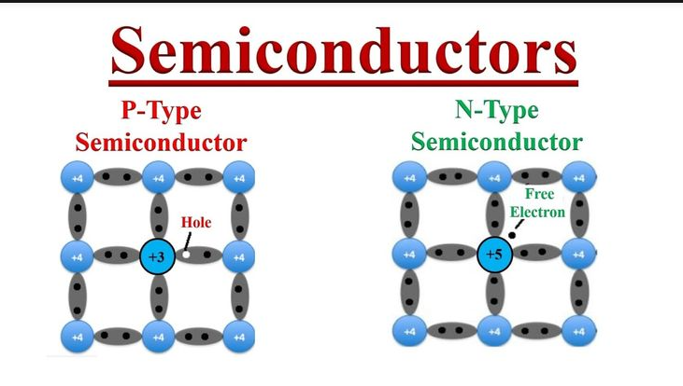

Slide 14
THANKYOU

